Slide 1
Web Development With React and Nodejs
By Rahul Roy and Arpan Sadhu

Slide 2
Internet

Slide 3
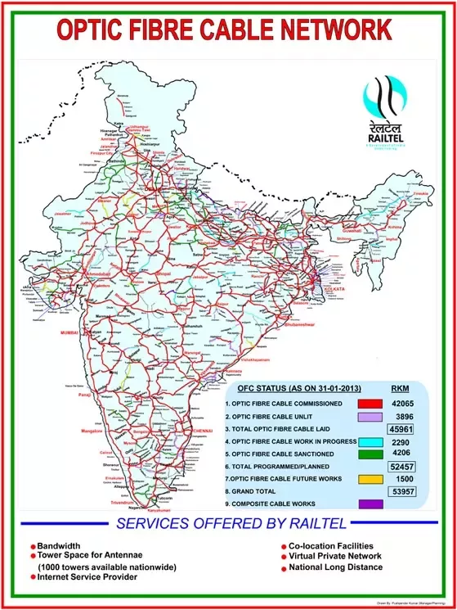

Slide 4
HTML5
Nodejs
CSS
Express
JS
MongoDB
React
Capstone Project

Slide 5
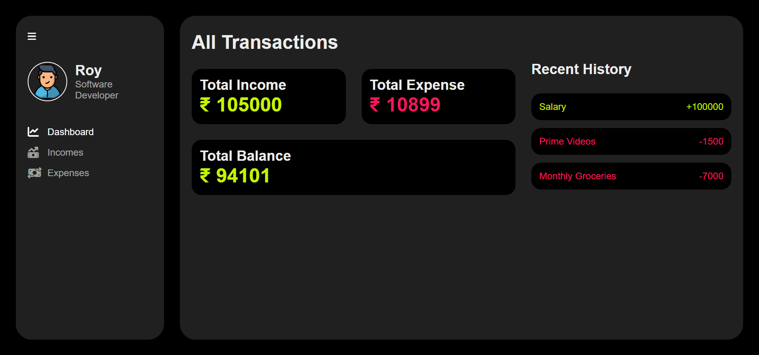
Expense Tracker

Slide 6
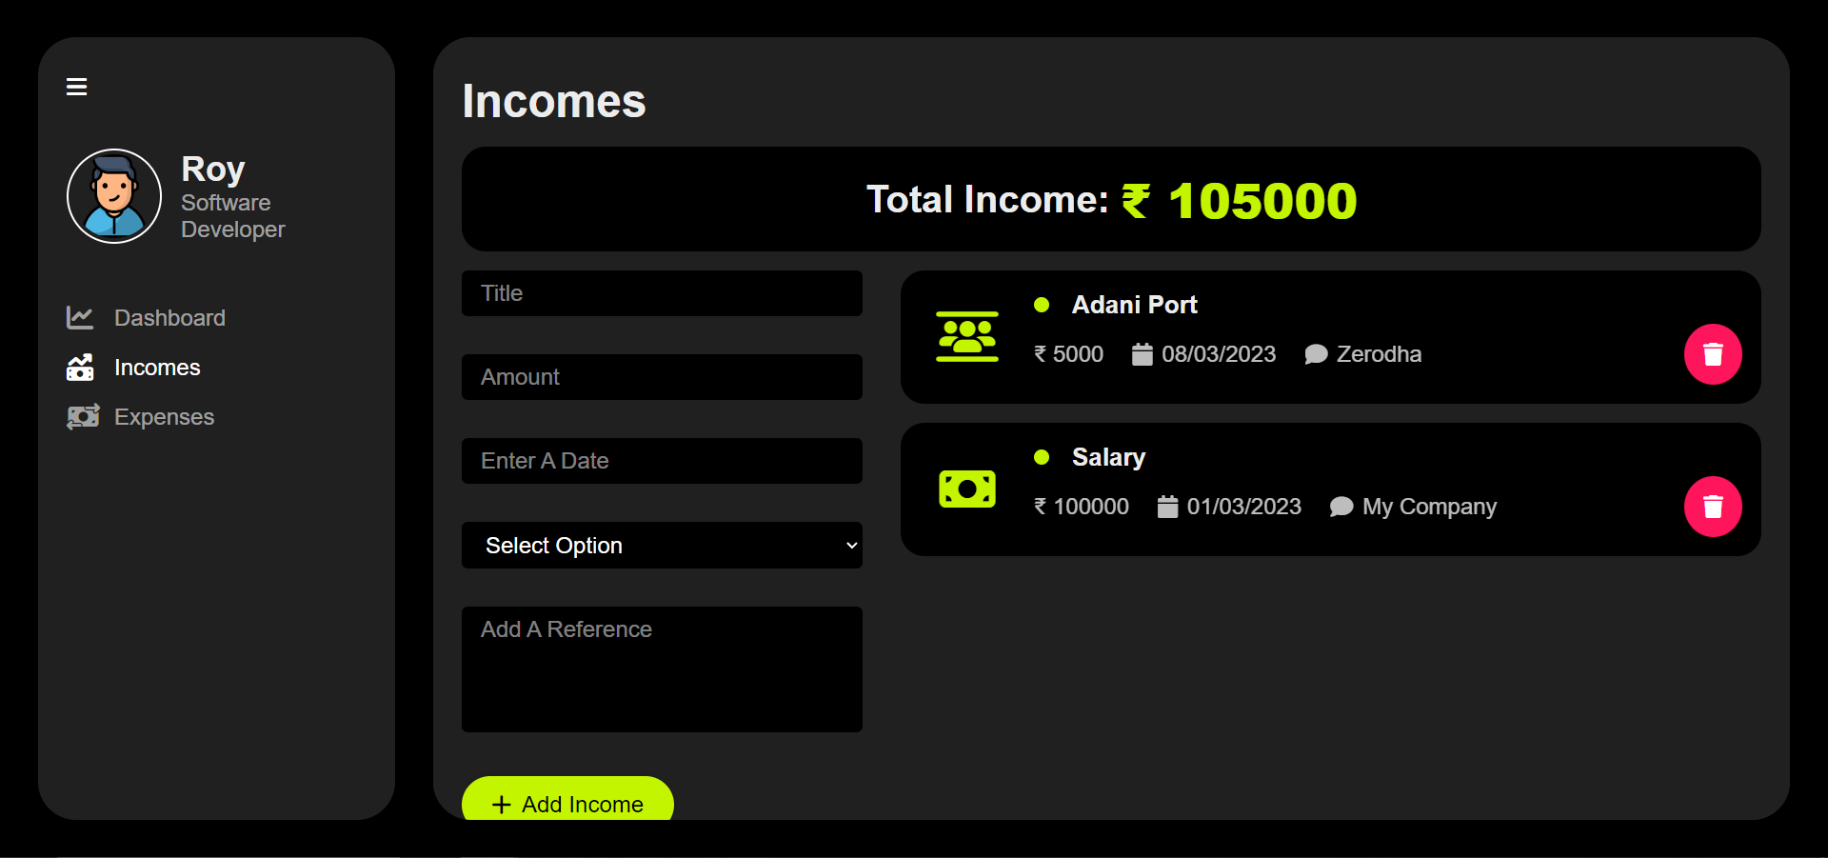
Expense Tracker

Slide 7
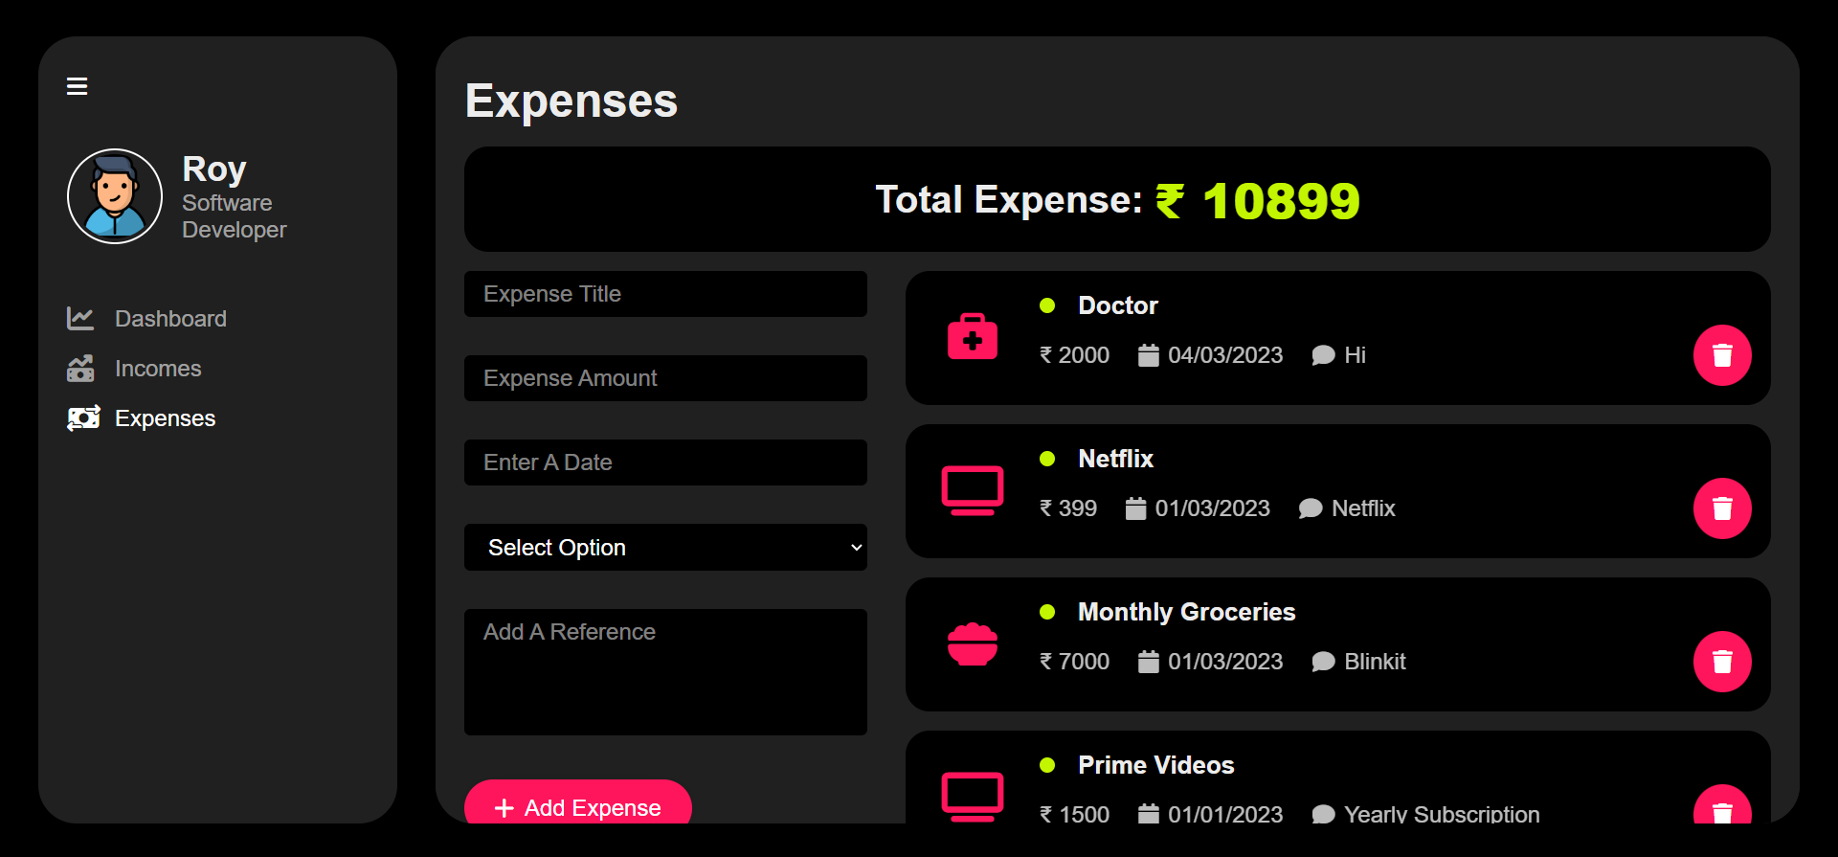
Expense Tracker

Slide 8
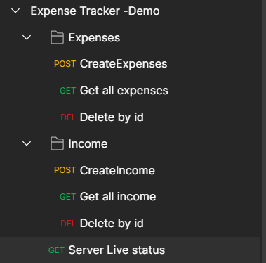
Expense Tracker
API Endpoints

Slide 9
Frontend

Slide 10
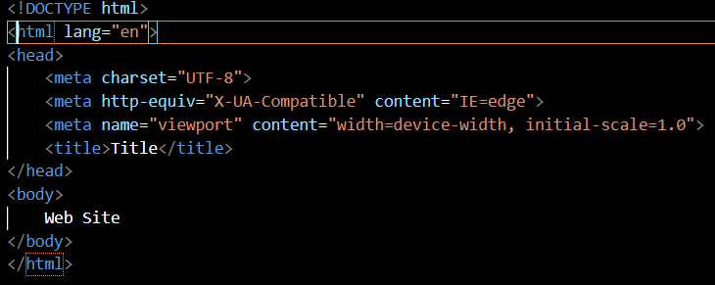
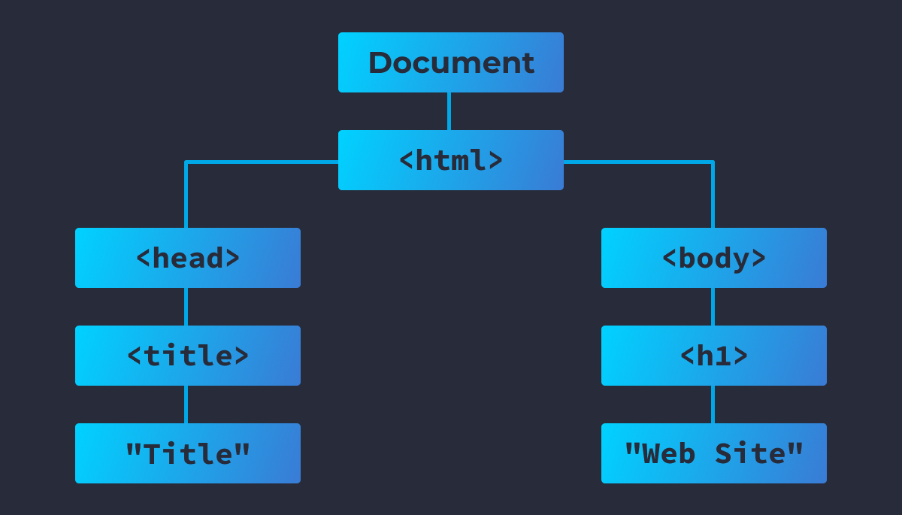
HTML

Slide 11
CSS
Specificity
Inline
Id
class
type

Slide 12
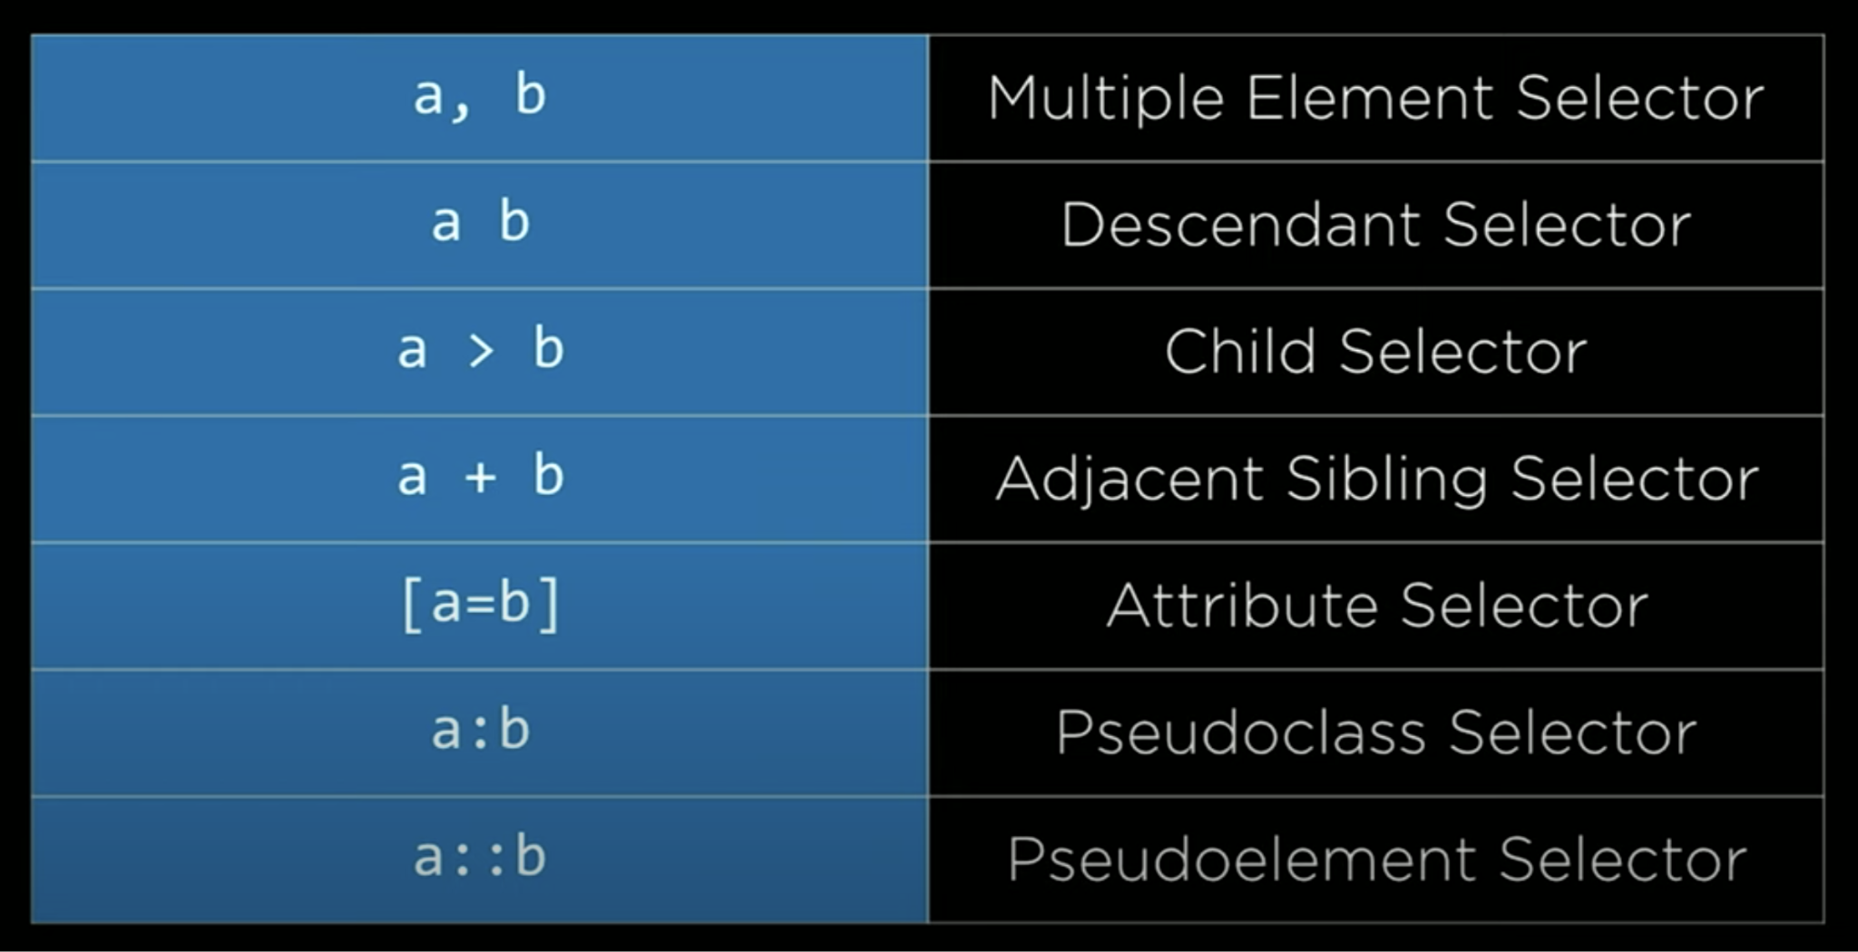
CSS

Slide 13
CSS
Responsive Design
viewport
media query
flexbox

Slide 14
Javascript

Slide 15
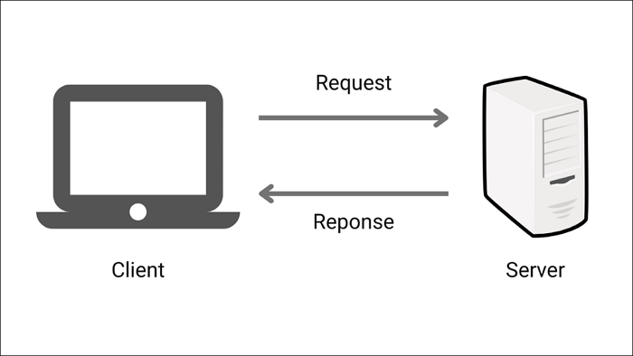

Slide 16
IF ELSE in JS
Similar to C++ or Java
if (condition) {
// block of code to be executed if the condition is true
} else {
// block of code to be executed if the condition is false
}

Slide 17
Backend

Slide 18
Node js
Notes:
So node js is a runtime environment whic runs js outside browser
Tool to run javascript outside the browser, It is interpreted language. Single threaded language

Slide 19
NPM
Package Manager for node
Backed by Microsoft
npmjs.com
Notes:
Reposiatory to host packages
Npm, or Node Package Manager, is a command-line tool that helps developers manage the dependencies of their projects. With npm, developers can easily install, update, and uninstall packages and libraries that their projects rely on.But npm is not just a tool for managing dependencies. It is also a community-driven ecosystem that fosters collaboration and knowledge sharing. Developers can publish their own packages and contribute to existing ones, building upon the work of others and helping to improve the overall quality of the ecosystem.
Demo go tp npmjs

Slide 20
Yarn
Faster than npm
Backed by facebook
https://yarnpkg.com/
Notes:
Yarn is a package manager that was created by Facebook to address some of the performance and security issues with npm. It has quickly become a popular choice among developers, particularly for larger projects with many dependencies.

Slide 21
Packages
Install package via npm
Npm install <package_name>
Uninstall a package via npm
Npm uninstall <package_name>
Install globally
Npm install -g <package_name>
Global packages
Global packages in Node.js are packages that are installed globally on your system and can be accessed from any directory or project. These packages provide command-line tools and utilities that can be used across different projects.
Local Packages
Notes:
npm view express
Global packages in Node.js are packages that are installed globally on your system and can be accessed from any directory or project. These packages provide command-line tools and utilities that can be used across different projects.
When you install a package globally, Node.js places the package binaries in a folder that is included in your system's PATH environment variable. This allows you to run the package's command-line tools from any directory on your system.

Slide 22
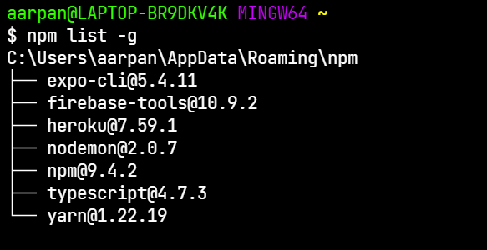
Packages
List all globally installed packages
Npm list -g
Notes:
npm view express
Global packages in Node.js are packages that are installed globally on your system and can be accessed from any directory or project. These packages provide command-line tools and utilities that can be used across different projects.
When you install a package globally, Node.js places the package binaries in a folder that is included in your system's PATH environment variable. This allows you to run the package's command-line tools from any directory on your system.

Slide 23
Versioning in NPM
X . Y . Z
X=major indicates a major release with breaking changes that are not backwards-compatible.
Y=minor indicates a minor release with new features or enhancements that are backwards-compatible.
Z=indicates a patch release with bug fixes and minor improvements that are backwards-compatible.
Notes:
npm view express
Global packages in Node.js are packages that are installed globally on your system and can be accessed from any directory or project. These packages provide command-line tools and utilities that can be used across different projects.
When you install a package globally, Node.js places the package binaries in a folder that is included in your system's PATH environment variable. This allows you to run the package's command-line tools from any directory on your system.

Slide 24
Let’s Get Started
Initialization
Npm init
and ans the questions (optional)
Package.json file created
Package lock.json
Notes:
npm view express
Global packages in Node.js are packages that are installed globally on your system and can be accessed from any directory or project. These packages provide command-line tools and utilities that can be used across different projects.
When you install a package globally, Node.js places the package binaries in a folder that is included in your system's PATH environment variable. This allows you to run the package's command-line tools from any directory on your system.

Slide 25
Plain Http Server
import * as http from 'http';
http.createServer((req, res) => {
//res.writeHead(200, { 'Content-Type': 'text/html' });
res.write("hello");
// console.log(res);
// console.log(req.url);
res.end();
}).listen(8000)
//netstat -a -b
Notes:
npm view express
Global packages in Node.js are packages that are installed globally on your system and can be accessed from any directory or project. These packages provide command-line tools and utilities that can be used across different projects.
When you install a package globally, Node.js places the package binaries in a folder that is included in your system's PATH environment variable. This allows you to run the package's command-line tools from any directory on your system.

Slide 26
Http Status Codes
https://http.cat/
Notes:
npm view express
Global packages in Node.js are packages that are installed globally on your system and can be accessed from any directory or project. These packages provide command-line tools and utilities that can be used across different projects.
When you install a package globally, Node.js places the package binaries in a folder that is included in your system's PATH environment variable. This allows you to run the package's command-line tools from any directory on your system.

Slide 27
Versioning in NPM
^ 4 . 0 . 9
= 4 . X . X // x will be maximised
~4 . 0 . 9
= 4 . 0 . X // x will be maximised

Slide 28
HTTP verbs
GET - retrieves information or resources from the server. GET requests should not modify any data on the server, and the response should be cacheable.
POST - submits data to the server, typically used for creating new resources on the server or updating existing resources. The data is sent in the request body.
PUT - updates an existing resource on the server. PUT requests should include the entire resource representation in the request body.
PATCH - updates part of an existing resource on the server. PATCH requests should include the specific changes to be made in the request body.
DELETE - deletes a resource on the server.
Notes:
npm view express
Global packages in Node.js are packages that are installed globally on your system and can be accessed from any directory or project. These packages provide command-line tools and utilities that can be used across different projects.
When you install a package globally, Node.js places the package binaries in a folder that is included in your system's PATH environment variable. This allows you to run the package's command-line tools from any directory on your system.

Slide 29
Get request
http.get('http://example.com', (response) => {
let data = '';
// A chunk of data has been received.
response.on('data', (chunk) => {
data += chunk;
});
// The whole response has been received.
response.on('end', () => {
console.log(data);
});
}).on("error", (error) => {
console.error(`Error: ${error.message}`);
});
Notes:
npm view express
Global packages in Node.js are packages that are installed globally on your system and can be accessed from any directory or project. These packages provide command-line tools and utilities that can be used across different projects.
When you install a package globally, Node.js places the package binaries in a folder that is included in your system's PATH environment variable. This allows you to run the package's command-line tools from any directory on your system.

Slide 30
This seems like toooo complicated
Notes:
npm view express
Global packages in Node.js are packages that are installed globally on your system and can be accessed from any directory or project. These packages provide command-line tools and utilities that can be used across different projects.
When you install a package globally, Node.js places the package binaries in a folder that is included in your system's PATH environment variable. This allows you to run the package's command-line tools from any directory on your system.

Slide 31
Express
import express from 'express';
const app = express();
app.listen(8000, () => {
console.log('server started');
})
Notes:
npm view express
Global packages in Node.js are packages that are installed globally on your system and can be accessed from any directory or project. These packages provide command-line tools and utilities that can be used across different projects.
When you install a package globally, Node.js places the package binaries in a folder that is included in your system's PATH environment variable. This allows you to run the package's command-line tools from any directory on your system.

Slide 32
Get Request With Express
import express from 'express';
const app = express();
app.get('/', (req, res, next) => {
// res.render(__dirname + './index.html')
})
app.listen(3000, () => {
console.log('server started');
})
Notes:
npm view express
Global packages in Node.js are packages that are installed globally on your system and can be accessed from any directory or project. These packages provide command-line tools and utilities that can be used across different projects.
When you install a package globally, Node.js places the package binaries in a folder that is included in your system's PATH environment variable. This allows you to run the package's command-line tools from any directory on your system.

Slide 33
Router in express
import express from 'express';
const app = express();
app.get('/', (req, res, next) => {
console.log(“Hello”)
})
app.get('/xyz', (req, res, next) => {
console.log(“Hello”2)
})
app.listen(3000, () => {
console.log('server started');
})
Notes:
npm view express
Global packages in Node.js are packages that are installed globally on your system and can be accessed from any directory or project. These packages provide command-line tools and utilities that can be used across different projects.
When you install a package globally, Node.js places the package binaries in a folder that is included in your system's PATH environment variable. This allows you to run the package's command-line tools from any directory on your system.

Slide 34
Middleware
Express middleware is a way to add functionality to an Express application by intercepting incoming HTTP requests before they reach their final destination.
Global Middleware
app.use(logger)
function logger(req, res, next) {
console.log("log");
next();
}
Local Middleware
function logger(req, res, next) {
console.log("log");
next();
}
app.get('/', logger, (req, res, next) => {
// res.render(__dirname + './index.html')
})
Notes:
npm view express
Backbone of express
When you install a package globally, Node.js places the package binaries in a folder that is included in your system's PATH environment variable. This allows you to run the package's command-line tools from any directory on your system.

Slide 35
MongoDB
Notes:
npm view express
Global packages in Node.js are packages that are installed globally on your system and can be accessed from any directory or project. These packages provide command-line tools and utilities that can be used across different projects.
When you install a package globally, Node.js places the package binaries in a folder that is included in your system's PATH environment variable. This allows you to run the package's command-line tools from any directory on your system.

Slide 36
Mongoose
Mongoose is a popular Object-Document Mapping (ODM) library for Node.js that provides a way to interact with MongoDB databases.
Notes:
npm view express
Global packages in Node.js are packages that are installed globally on your system and can be accessed from any directory or project. These packages provide command-line tools and utilities that can be used across different projects.
When you install a package globally, Node.js places the package binaries in a folder that is included in your system's PATH environment variable. This allows you to run the package's command-line tools from any directory on your system.

Slide 37
Connection to the database
import mongoose from 'mongoose';
const connect = () => mongoose.connect("mongodb://127.0.0.1/test").then(
() => {
console.log("Database connected...")
}).catch((err) => {
console.log("Server connection error");
console.log(err);
process.exit(1);
});
export default connect;
Notes:
npm view express
Global packages in Node.js are packages that are installed globally on your system and can be accessed from any directory or project. These packages provide command-line tools and utilities that can be used across different projects.
When you install a package globally, Node.js places the package binaries in a folder that is included in your system's PATH environment variable. This allows you to run the package's command-line tools from any directory on your system.

Slide 38
Schema
import mongoose from "mongoose";
const nameSchema = new mongoose.Schema({
name: {
type: String,
},
email:{
type:String,
}
} )
const name = mongoose.model('name', nameSchema);
export default name;
Notes:
npm view express
Global packages in Node.js are packages that are installed globally on your system and can be accessed from any directory or project. These packages provide command-line tools and utilities that can be used across different projects.
When you install a package globally, Node.js places the package binaries in a folder that is included in your system's PATH environment variable. This allows you to run the package's command-line tools from any directory on your system.

Slide 39
Entry to the database
app.use(express.json())
async function dbEntry(req, res) {
const name = req.body.name;
const email = req.body.email;
const users = await user.create({
name: name,
email: email
});
res.status(200).json({ message: "success" })
}
app.post('/db-entry', dbEntry)
Notes:
npm view express
Global packages in Node.js are packages that are installed globally on your system and can be accessed from any directory or project. These packages provide command-line tools and utilities that can be used across different projects.
When you install a package globally, Node.js places the package binaries in a folder that is included in your system's PATH environment variable. This allows you to run the package's command-line tools from any directory on your system.

Slide 40
Query to the database
dbname.findById(id )
dbname.find({});
dbName.updateOneById(id,{new value });
dbName.deleteOneById(id,{condition})
Notes:
npm view express
Global packages in Node.js are packages that are installed globally on your system and can be accessed from any directory or project. These packages provide command-line tools and utilities that can be used across different projects.
When you install a package globally, Node.js places the package binaries in a folder that is included in your system's PATH environment variable. This allows you to run the package's command-line tools from any directory on your system.

Slide 41
Query to the database
app.use(express.json())
async function dbFindById(req, res) {
const name = req.body.name;
const email = req.body.email;
const users = await user.findById(req.body.id);
res.status(200).json({ message: "success" ,data:users})
}
app.post('/db-find, dbFindById);
Notes:
npm view express
Global packages in Node.js are packages that are installed globally on your system and can be accessed from any directory or project. These packages provide command-line tools and utilities that can be used across different projects.
When you install a package globally, Node.js places the package binaries in a folder that is included in your system's PATH environment variable. This allows you to run the package's command-line tools from any directory on your system.

Slide 42
Notes:
npm view express
Global packages in Node.js are packages that are installed globally on your system and can be accessed from any directory or project. These packages provide command-line tools and utilities that can be used across different projects.
When you install a package globally, Node.js places the package binaries in a folder that is included in your system's PATH environment variable. This allows you to run the package's command-line tools from any directory on your system.

Slide 43
React
Open Source Library for building UI
Focus on building rich UI
Rich Ecosystem
Created by Facebook
> 100k stars on Github
Huge Community
Notes:
npm view express
Global packages in Node.js are packages that are installed globally on your system and can be accessed from any directory or project. These packages provide command-line tools and utilities that can be used across different projects.
When you install a package globally, Node.js places the package binaries in a folder that is included in your system's PATH environment variable. This allows you to run the package's command-line tools from any directory on your system.

Slide 44
React is Declarative
Declarative programming is a programming paradigm, that expresses logic of a computation without describing its control flow.
React will effectively handle updating and rendering of components.
DOM Updates are effectively handled by React - Lifecycle methods.
Notes:
npm view express
Global packages in Node.js are packages that are installed globally on your system and can be accessed from any directory or project. These packages provide command-line tools and utilities that can be used across different projects.
When you install a package globally, Node.js places the package binaries in a folder that is included in your system's PATH environment variable. This allows you to run the package's command-line tools from any directory on your system.

Slide 45
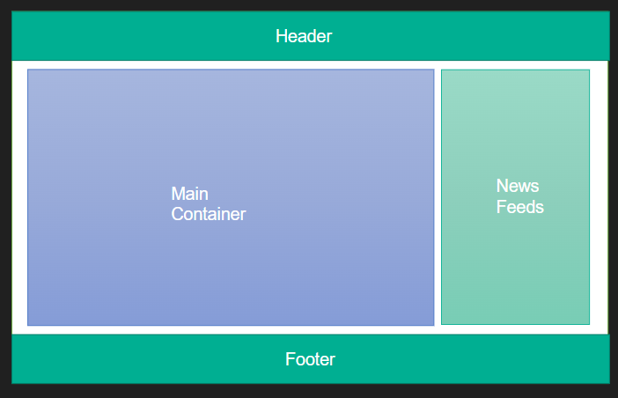
Component Based Architecture
Notes:
npm view express
Global packages in Node.js are packages that are installed globally on your system and can be accessed from any directory or project. These packages provide command-line tools and utilities that can be used across different projects.
When you install a package globally, Node.js places the package binaries in a folder that is included in your system's PATH environment variable. This allows you to run the package's command-line tools from any directory on your system.

Slide 46
Create React App
using npx (package runner)
npx create-react-app <proj_name>
using npm (package manager) npm install create-react-app -g
create-react-app <proj_name>
or
npm init react-app <proj_name>
using yarn (package manager) yarn create react-app <proj_name>
Notes:
npm view express
Global packages in Node.js are packages that are installed globally on your system and can be accessed from any directory or project. These packages provide command-line tools and utilities that can be used across different projects.
When you install a package globally, Node.js places the package binaries in a folder that is included in your system's PATH environment variable. This allows you to run the package's command-line tools from any directory on your system.

Slide 47
Components
Class Components
Functional Components
Notes:
npm view express
Global packages in Node.js are packages that are installed globally on your system and can be accessed from any directory or project. These packages provide command-line tools and utilities that can be used across different projects.
When you install a package globally, Node.js places the package binaries in a folder that is included in your system's PATH environment variable. This allows you to run the package's command-line tools from any directory on your system.

Slide 48
JSX
Javascript XML - extension to javascript language syntax.
Write XML like code for elements and components.
React.createElement(name, attribute, children)
Transpile to pure JS
Notes:
npm view express
Global packages in Node.js are packages that are installed globally on your system and can be accessed from any directory or project. These packages provide command-line tools and utilities that can be used across different projects.
When you install a package globally, Node.js places the package binaries in a folder that is included in your system's PATH environment variable. This allows you to run the package's command-line tools from any directory on your system.

Slide 49
Conditional Rendering
if/else
element variables
ternary
short circuit
Notes:
npm view express
Global packages in Node.js are packages that are installed globally on your system and can be accessed from any directory or project. These packages provide command-line tools and utilities that can be used across different projects.
When you install a package globally, Node.js places the package binaries in a folder that is included in your system's PATH environment variable. This allows you to run the package's command-line tools from any directory on your system.

Slide 50
React Hooks
useState
useEffect
useContext
Notes:
npm view express
Global packages in Node.js are packages that are installed globally on your system and can be accessed from any directory or project. These packages provide command-line tools and utilities that can be used across different projects.
When you install a package globally, Node.js places the package binaries in a folder that is included in your system's PATH environment variable. This allows you to run the package's command-line tools from any directory on your system.

Slide 51
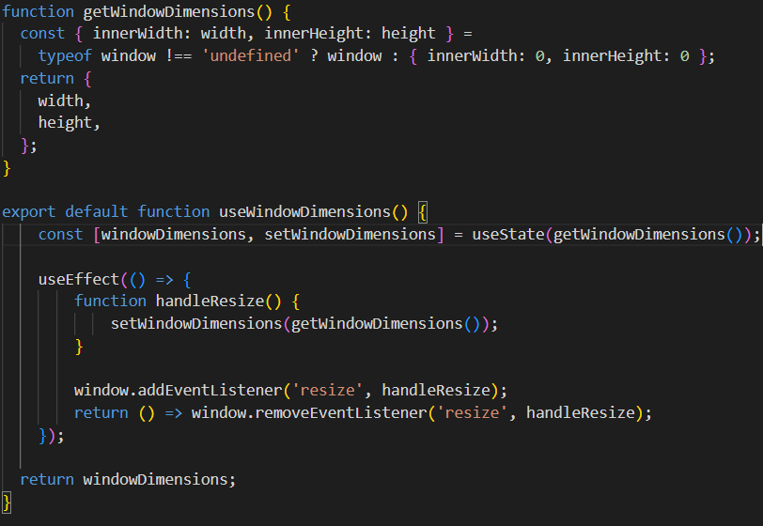
Custom Hooks
Notes:
npm view express
Global packages in Node.js are packages that are installed globally on your system and can be accessed from any directory or project. These packages provide command-line tools and utilities that can be used across different projects.
When you install a package globally, Node.js places the package binaries in a folder that is included in your system's PATH environment variable. This allows you to run the package's command-line tools from any directory on your system.

Slide 52
Styling React Components
CSS Stylesheets
Inline Styling
CSS in Js Library (styled-component)
Notes:
npm view express
Global packages in Node.js are packages that are installed globally on your system and can be accessed from any directory or project. These packages provide command-line tools and utilities that can be used across different projects.
When you install a package globally, Node.js places the package binaries in a folder that is included in your system's PATH environment variable. This allows you to run the package's command-line tools from any directory on your system.

Slide 53
What Next?

Slide 54
References
https://filisantillan.com/bits/dom/
https://qph.cf2.quoracdn.net/main-qimg-3c7120b1fc0aff273047260e786721da.webp
https://cs50.harvard.edu/web/2020/notes/0/

